Slide 1
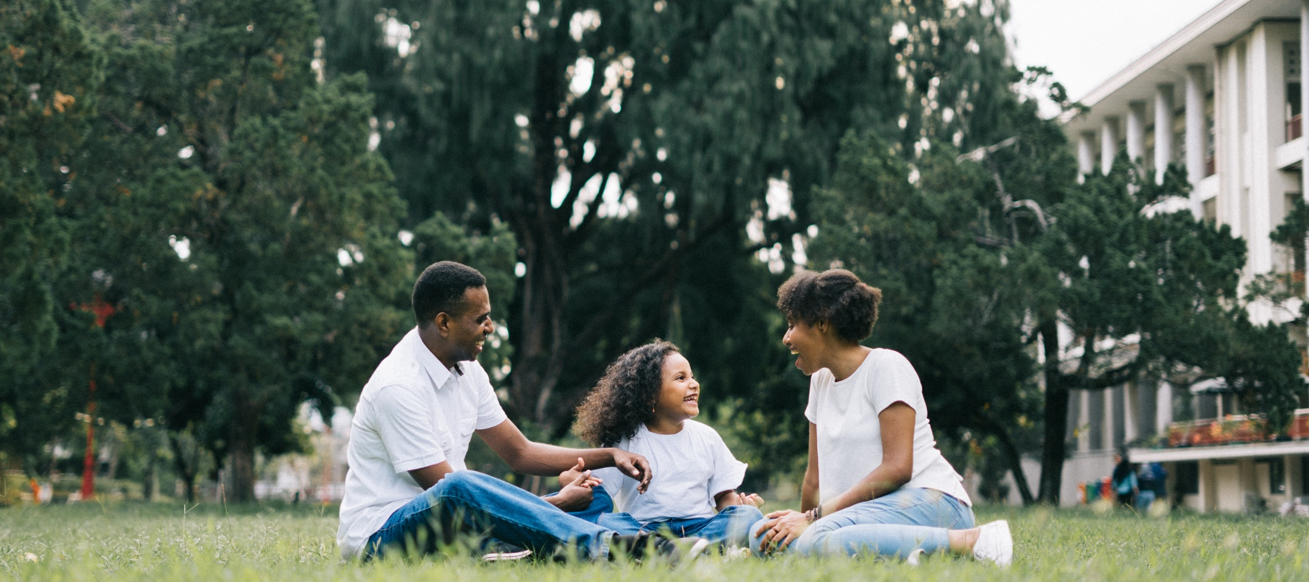
^{Families Forming Disciples}
Lesson 1 - Week 1

Slide 2


Topic: The Domestic Church & Parents as the Primary Educators of the Faith
REFERENCES:
CCC PASSAGES:
CREED
LITURGY
LIFE
PRAYER
^{CCC: 2223}
^{Prv 22:6}
^{Eph 6:1-4}
^{nos.}
⁵³¹⁻⁵³⁴
^{nos.}
¹⁶⁵⁵⁻¹⁶⁵⁸
^{nos.}
²²¹⁴⁻²²³³
^{nos.}
²⁶⁸⁵
&
²⁶⁸⁸

Slide 3
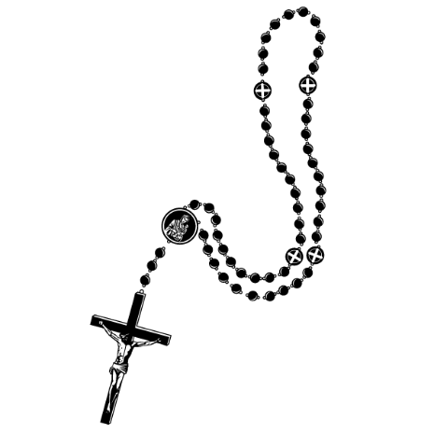
^{Opening Prayer}
^{We bless your name, O Lord,}
for sending your own incarnate Son,
^{to become part of a family,}
^{so that, as he lived its life,}
he would experience its worries and its joys.
^{We ask you, Lord,}
to protect and watch over this family,
so that in the strength of your grace
its members may enjoy prosperity,
possess the priceless gift of your peace,
and, as the Church alive in the home,
bear witness in this world to your glory.
We ask this though Christ our Lord.
^{Amen.}
Catholic Household Blessings & Prayers © 2007, USCCB Publishing. All rights reserved.
Used with permission of the International Commission on English in the Liturgy Corporation.

Slide 4
^{Ice Breaker}
^{Option 1: Childhood Dream}
Ask the participants to share their childhood dream (what they want/wanted to be or do when they grow/grew up) and then ask them to reflect on how this correlates with their current aspirations (if applicable). Depending on the time and amount of people in the group you may ask them just to give you one-word responses, like astronaut, ballerina, teacher, etc.
^{Option 2: The Time Machine}
Ask the participants the following question(s): “If you were able to travel through time, what time period would you want to visit and why? If there was a person you would go back in time to meet, who would it be, and why?”

Slide 5

Who taught you about God and our faith?

Slide 6

Our Topic for this month
^{The Domestic Church and}
^{parents as primary educators.}

Slide 7
^{Content}
Many of us have had similar experiences to those in the video we just watched. We most likely learned about our faith in some way from our family. Our parents, grandparents, aunts and uncles have possibly been examples to us and shared their life of faith and relationship with Jesus with us. They have taught us prayers, shared traditions with us, and brought us to the sacraments. We are able to see that growing up in an environment that is rich in Catholic traditions, prayers, and service is very important for nurturing one’s faith life.
When the Catholic Church talks about the “Domestic Church,” she is speaking about this very principle. The home is where we are meant to encounter Jesus and grow in our faith, and our parishes are meant to support families in their walk of discipleship. Parents are the “primary educators” of the faith, and no one is better suited or positioned to teach the faith to their children.
This may be an easier principle to understand since we have had the experience of learning and working from home during the COVID-19 crisis. Most of us have experienced being unable to go to church in person, instead watching and praying the Mass online together as a family at home. This has reminded us that our homes are true churches—Domestic Churches—where we encounter Jesus. All of our homes are centers for education, work, enrichment, and faith. Our Catholic faith is meant to be shared and lived in the home so that our homes become places “where tenderness, forgiveness, respect, and fidelity” can grow and thrive.
Ultimately, we look to Jesus to understand what it means to be a Domestic Church. Jesus lived most of His life on earth in the hiddenness, joys, labors, and sufferings of family life (see Mt 1:18 – 2:23; Lk 1:26 – 2:52). God the Son came to us through a family, the Holy Family, and by so doing He united Himself in a certain way to every family (see St. John Paul II). Jesus is with us. His presence and grace in the sacraments makes our families Domestic Churches. Lord, help us to rely on You and Your grace more, and may we share You as Mary and Joseph did—with the world!

Slide 8
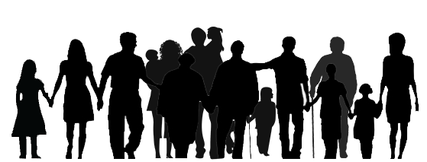
Family Conversation
Who in your family teaches or has taught you the most about God?
First families reflect and discuss the question together (mute for privacy),
and then catechists facilitate large group sharing (unmute).

Slide 9
Mission
1. Introduce Mission Activities
Mission Activities are to be done at home during Week 2 and to be shared at the gathering of families on Week 3.
^{2. Explain Activity}
^{Watch this video} ^{(stop at}
3:43), and build a prayer corner in your home.
^{3. Family Sharing}
Provide visual example by Show ‘n Telling how you have built your own prayer corner and how you have taken time to pray.

Slide 10

^{Review & Close in Prayer}
Review briefly the goals of the lesson and remind everyone of the expectations for week 2 and 3.
Option 1: Pray together the Our Father
Option 2: Lord Jesus, may you bless each of the families gathered together today. Help us to
continually grow closer to you. This we pray in Your Holy Name. Amen.

